Slide 1
Differential Equations
By Bofang Jia

Slide 3
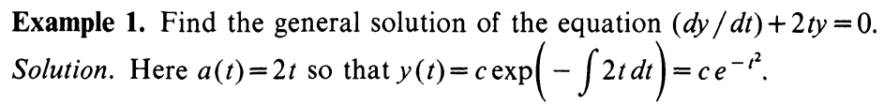
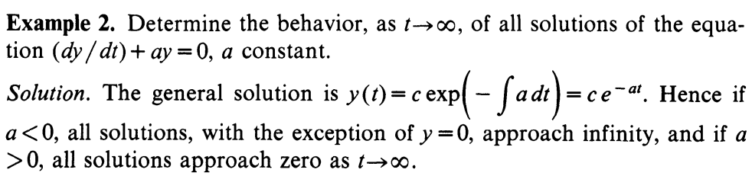

Slide 4
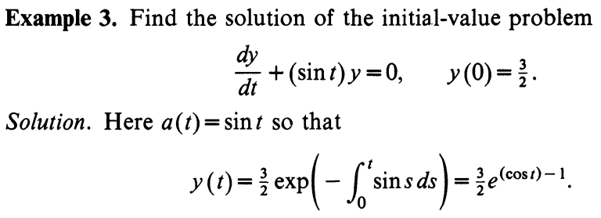
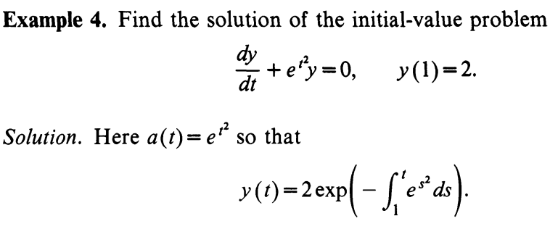

Slide 5
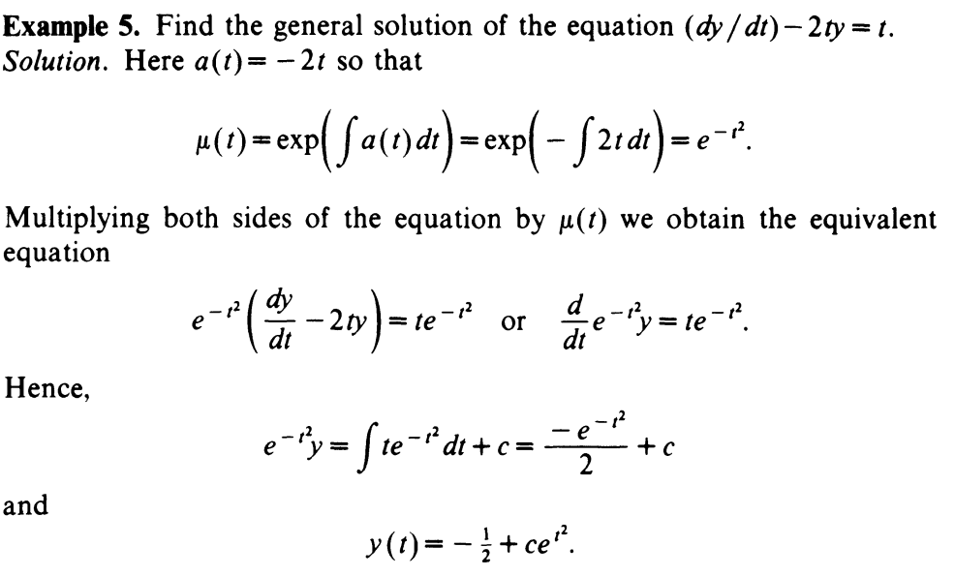

Slide 6
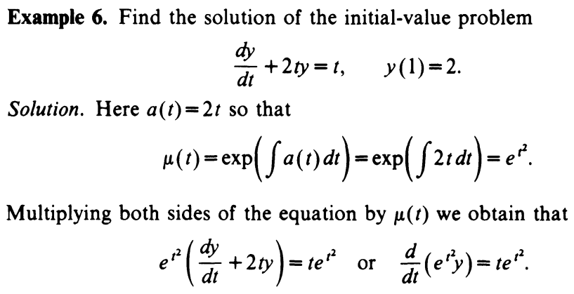

Slide 7
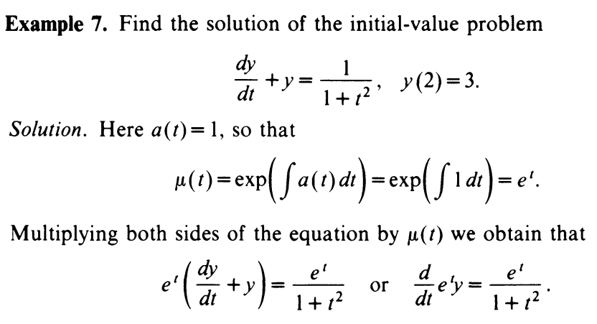

Slide 8
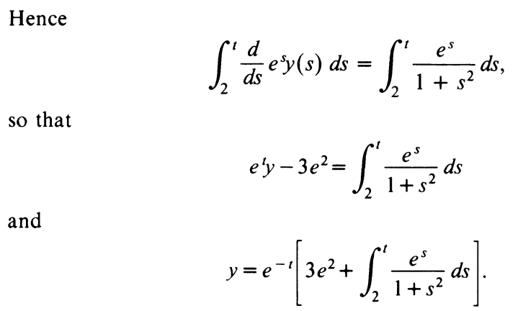

Slide 9
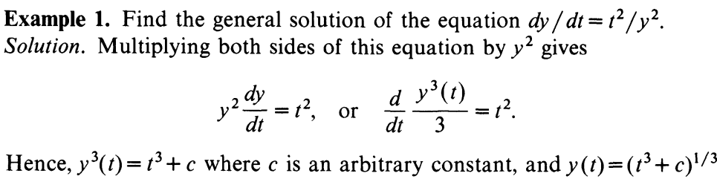
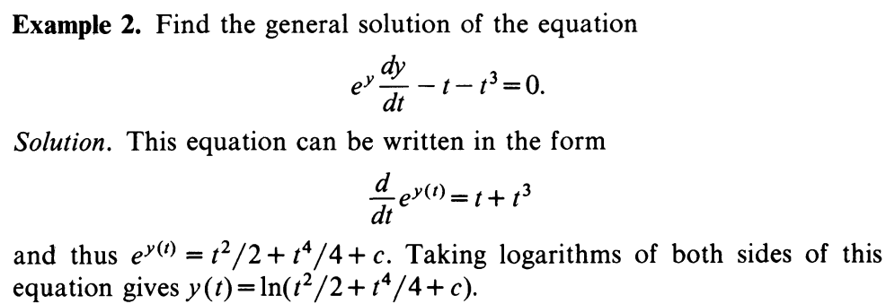

Slide 10
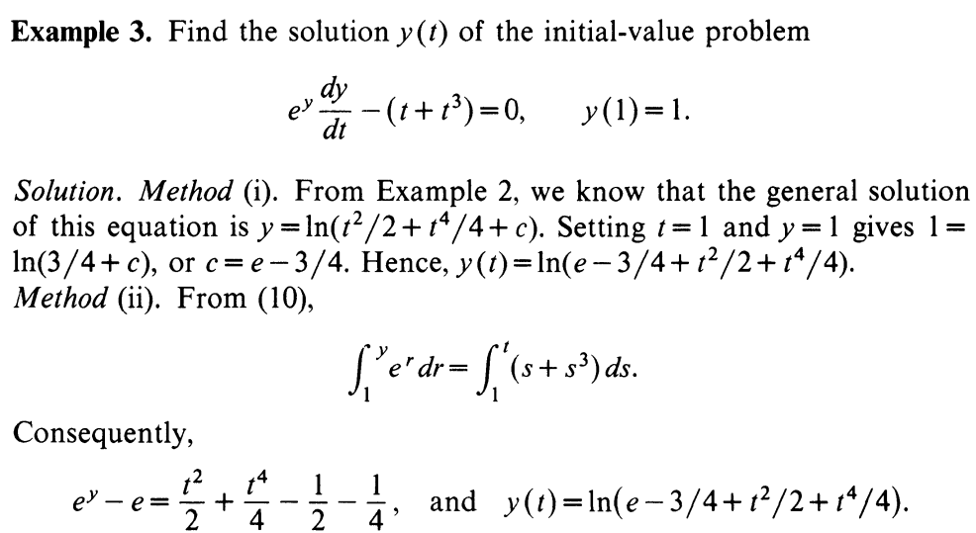

Slide 11
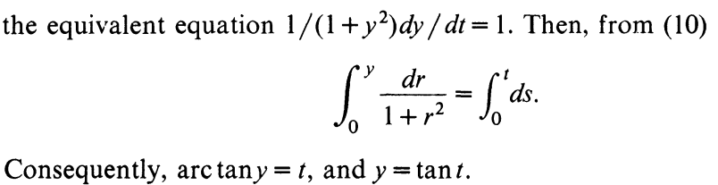
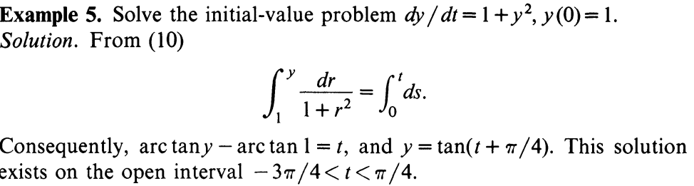

Slide 12
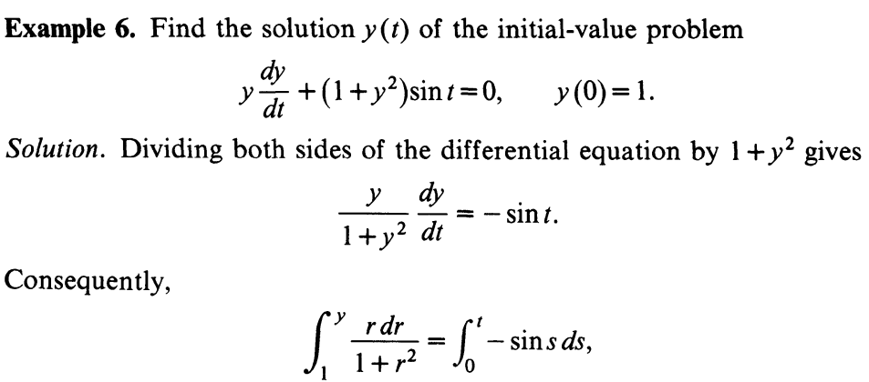
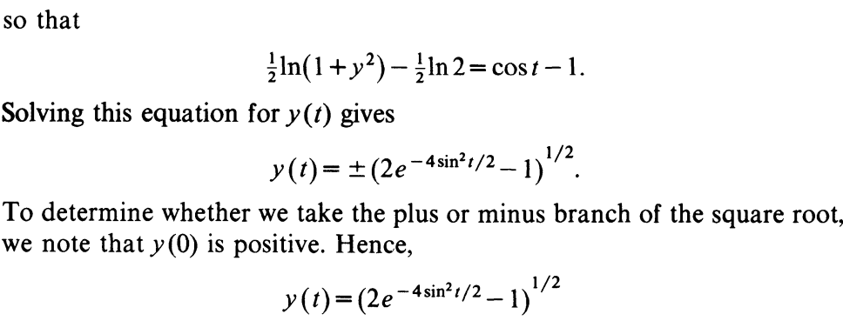

Slide 13
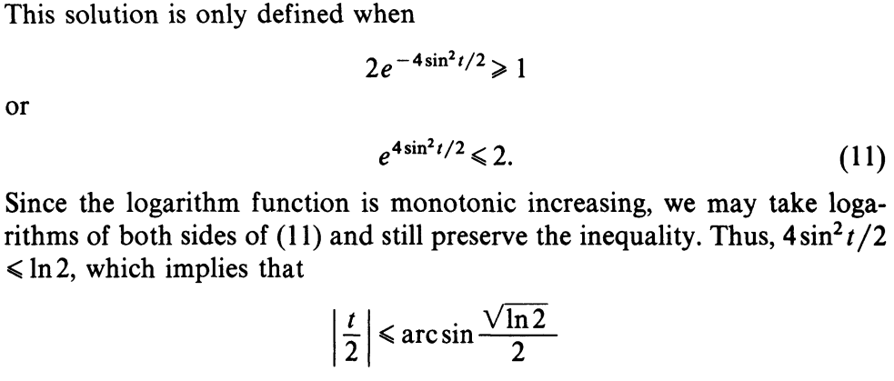

Slide 14
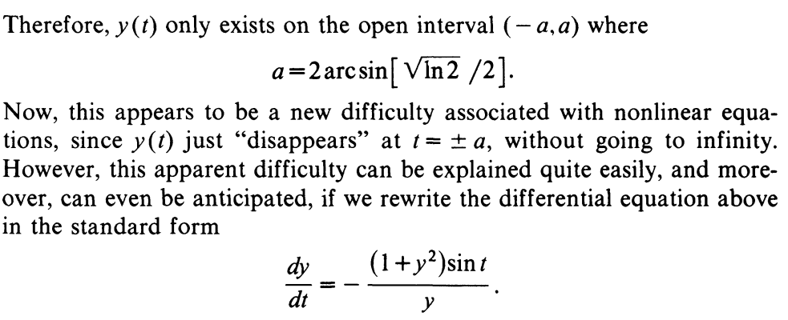
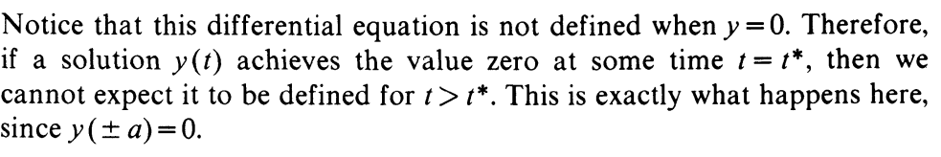

Slide 15
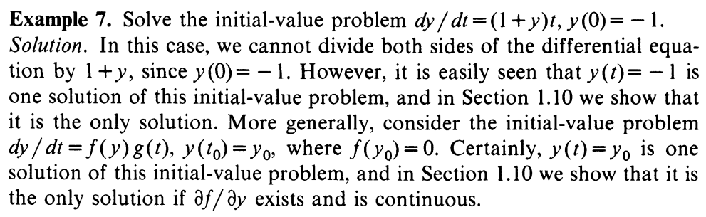

Slide 16
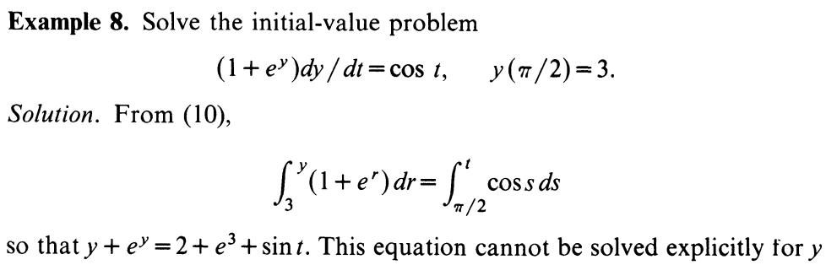
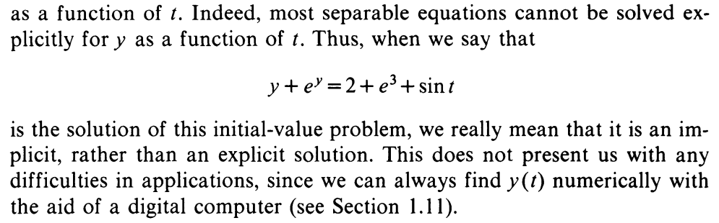

Slide 17
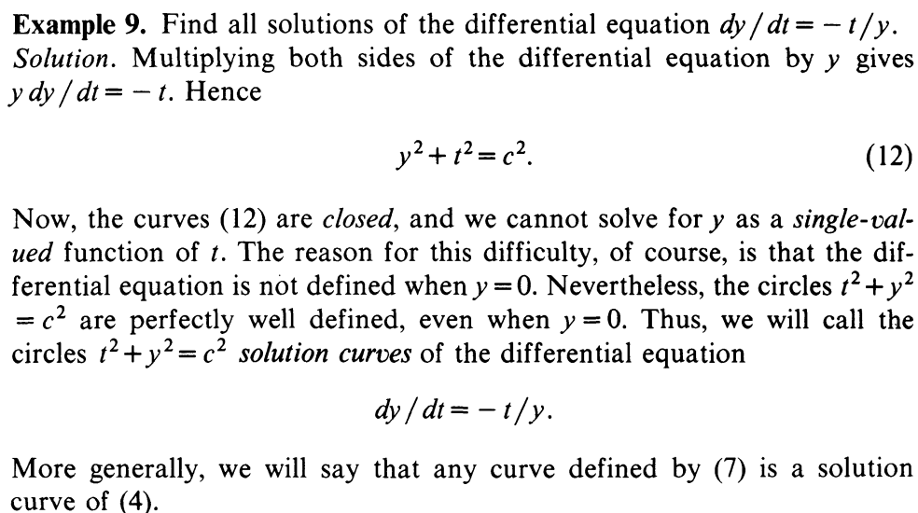

Slide 18
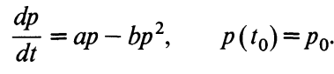
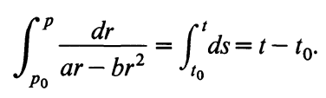
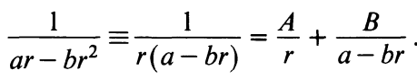
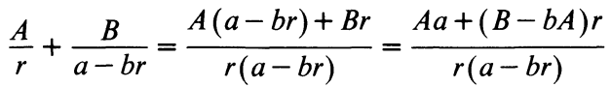
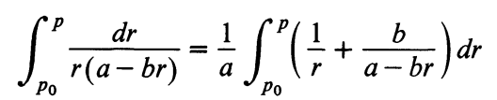
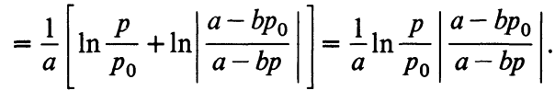

Slide 19
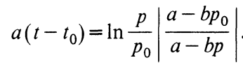
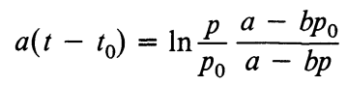
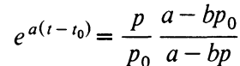
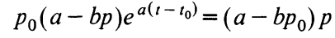
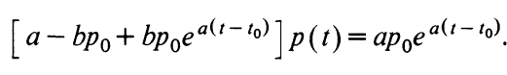
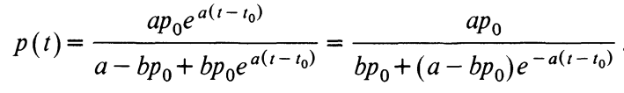
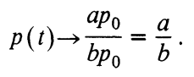

Slide 20
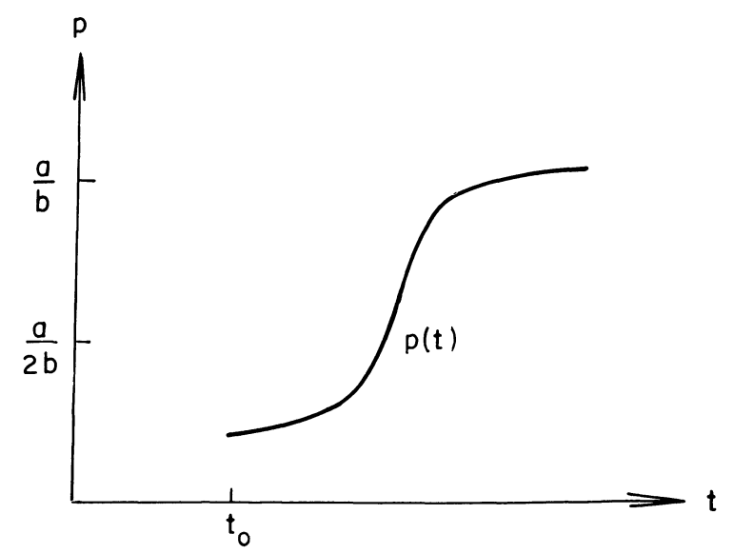

Slide 21
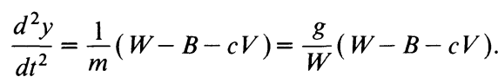
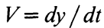
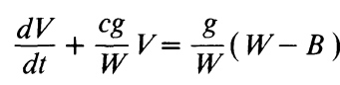
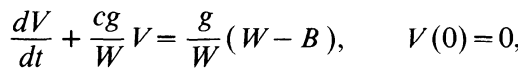
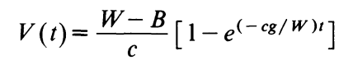

Slide 22
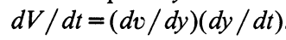
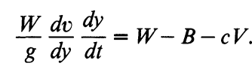
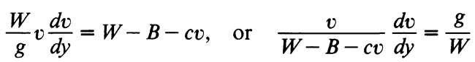
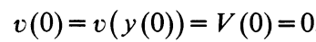
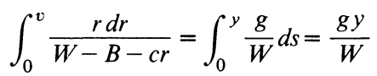
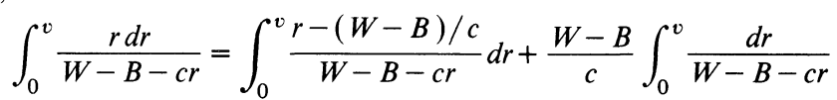

Slide 23
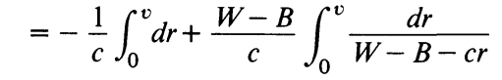
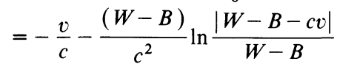
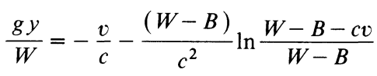




Slide 24




Slide 25



Slide 26











Slide 27











Slide 28


Slide 29



Slide 30


Slide 31


Slide 32


Slide 33


Slide 34


Slide 35




Slide 36



Slide 37


Slide 38


Slide 39


Slide 40







Slide 41


Slide 42



Slide 43


Slide 44


Slide 45




Slide 46


Slide 47



Slide 48


Slide 49


Slide 50


Slide 51





Slide 52


Slide 53


Slide 54






Slide 55




Slide 56



Slide 57


Slide 58


Slide 59


Slide 60


Slide 61





Slide 62


Slide 63


Slide 64


Slide 65


Slide 66


Slide 67


Slide 68



Slide 69


Slide 70


Slide 71


Slide 72


Slide 73


Slide 74


Slide 75



Slide 76


Slide 77



Slide 78






Slide 79


Slide 80


Slide 81


Slide 82


Slide 83


Slide 84


Slide 85



Slide 86


Slide 87


Slide 88


Slide 89


Slide 90



Slide 91



Slide 92



Slide 93


Slide 94



Slide 95


Slide 96


Slide 97



Slide 98


Slide 99


Slide 100


Slide 101


Slide 102



Slide 103


Slide 104


Slide 105




Slide 106



Slide 107




Slide 108


Slide 109


Slide 110



Slide 111


Slide 112


Slide 113


Slide 114



Slide 115


Slide 116



Slide 117



Slide 118


Slide 119


Slide 120


Slide 121


Slide 122



Slide 123


Slide 124


Slide 125


Slide 126






Slide 127




Slide 128



Slide 129


Slide 130


Slide 131


Slide 132


Slide 133


Slide 134


Slide 135



Slide 136


Slide 137


Slide 138


Slide 139


Slide 140


Slide 141


Slide 142


Slide 143


Slide 144


Slide 145


Slide 146


Slide 147


Slide 148



Slide 149



Slide 150




Slide 151


Slide 152


Slide 153


Slide 154


